Slide 1
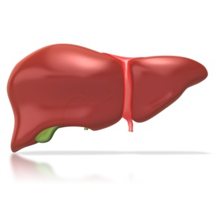
Liver Disorder using Machine Learning
Team members:
Perumalla Litesh
Satish Gudapati
Akash Chittimalla

Slide 2
Introduction
Liver Function and Importance:
Detoxification: Breakdown of harmful substances.
Metabolism: Conversion of nutrients from food.
Protein Synthesis: Responsible for Synthesis of various Proteins
Storage: Stores important substances like glycogen, vitamins.
Bile Production: A digestive fluid helps in breakdown and absorption of fats.

Slide 3
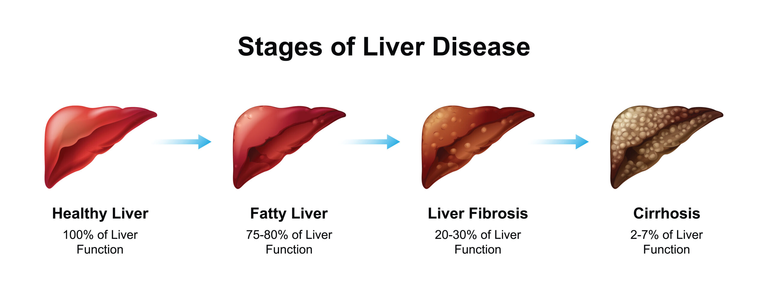
Liver Disorders
Hepatitis: Inflammation of liver
Cirrhosis: Scarring of the liver tissue.
Fatty Liver diseases: Accumulation of fat in the liver.
Liver Cancer: Uncontrolled growth of cells in the liver.
Hemochromatosis: Excessive iron accumulation in the liver.
Autoimmune Hepatitis: Attack of Immune system on liver cells.

Slide 4
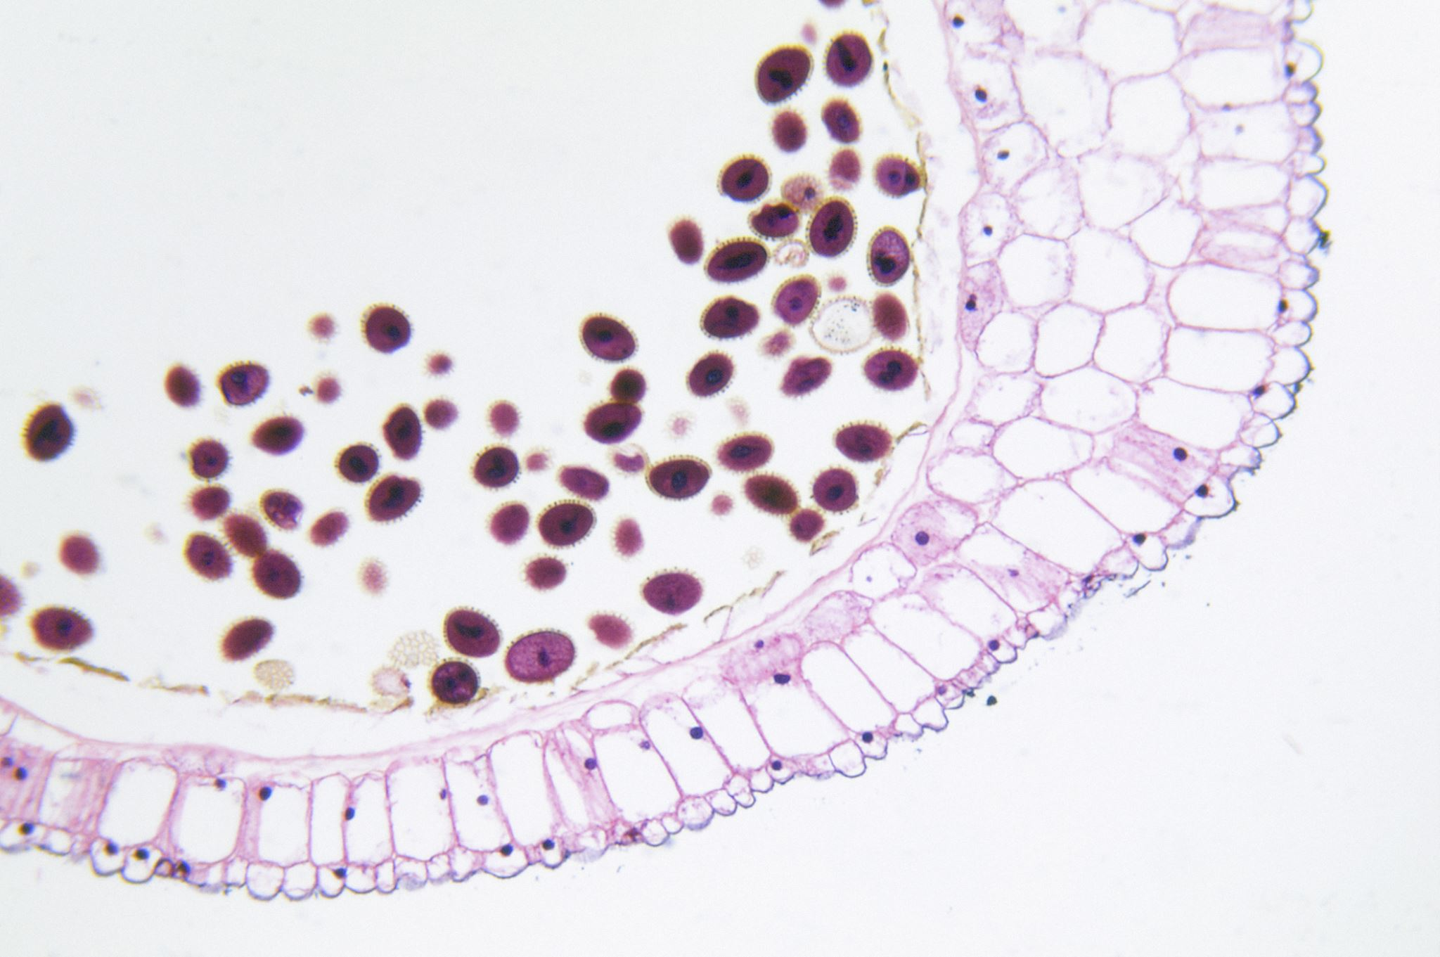
Existing Methodology
Traditional Diagnostic Methods:
Blood Tests: Liver Enzyme Tests and Bilirubin tests.
Image Detailing: CT scans, MRI scans
Biopsy: Examining a liver tissue under a microscope.

Slide 5
Existing Methodologies in Machine Learning Models
AI for the Management of Hepatitis, Steatosis, and Liver Cirrhosis: model for classifying the stages of chronic hepatitis B.
AI Models for CT and MRI : CNN based model for diagnosis of Mailgnant tumors.
Non-alcoholic steatohepatitis (NASH) from non-alcoholic fatty liver disease (NAFLD).
AI Models for Liver Tumors: a model with 96% accuracy for the classification of cysts, hemangiomas, and malignant tumors.

Slide 6
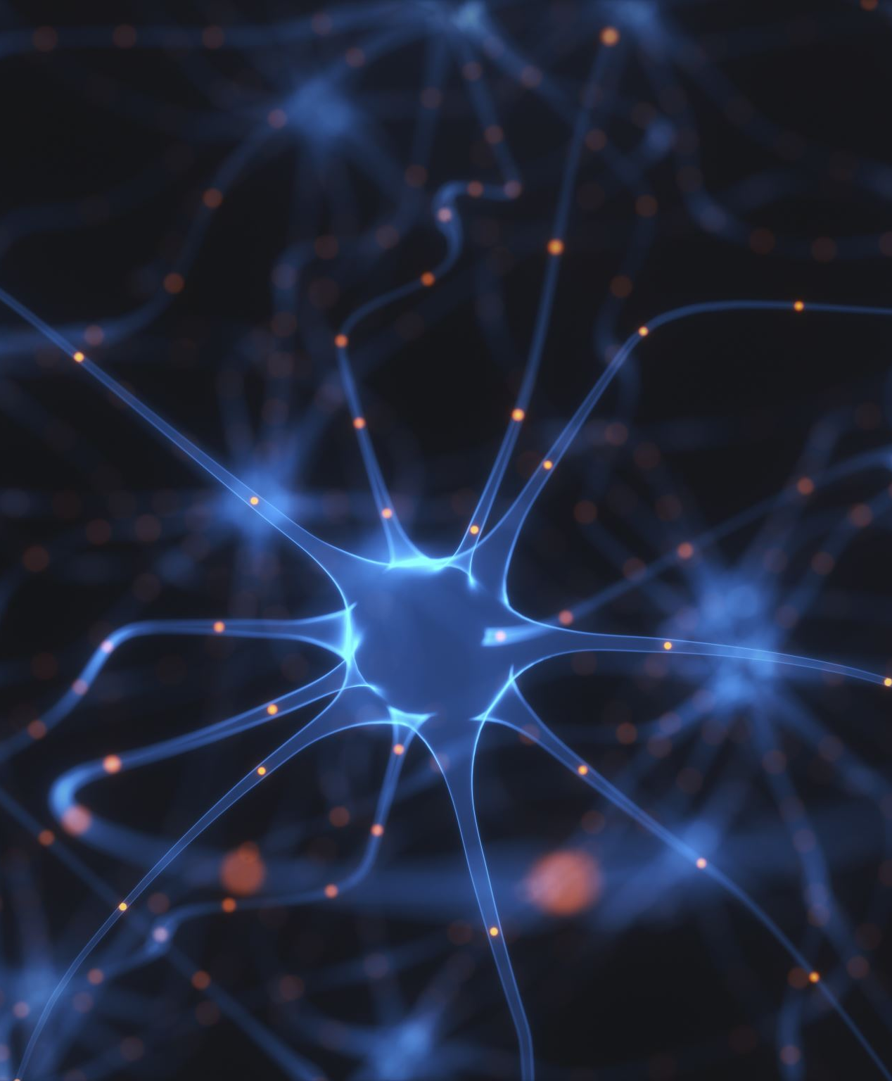
Project Proposal
Algorithm: MLP (Multi Layer Perceptron)
It is a type of Artificial Neural Network.
It consists of a single node or neuron that takes a row of data as input and predicts a class label.

Slide 7

Model Architecture
Components of the model
Input Layer: Neurons in the input layer represent the features of the input data. Each neuron corresponds to a specific feature.
Hidden Layer: Neurons in the hidden layers process the input data through weighted connections and apply activation functions.
Weights and Bias: ach connection between neurons has an associated weight, representing the strength of the connection.
Activation Function: ach neuron typically applies an activation function to the weighted sum of its inputs.
Output Layer: Neurons in the output layer provide the final predictions of the model.
Traning: Algorithm Adjusts the weight and bias.

Slide 8
Project Outcomes
Improved Accuracy.
Reduced Diagnosis Time.
Scalability.
Enhanced Understanding.

Slide 9
References
Dataset Source
MLP Algorithm
AI Models on Liver Disorders
Types of Liver Disorders
Research paper

